Slide 1
i2b2 – caGrid Data Services
i2b2 (Informatics for Integrating Biology and the Bedside) provides a mechanism for storing clinical research data
Utilizes a Star Schema style database
Allows storage of arbitrary data types, but makes retrieval of typed information complicated
OntoMapper tool by UCSF bridges this data to the semantically annotated world of caBIG
Assigns CDEs from caDSR to data elements identified by a query path
i2b2 Data Services will provide query capabilities into an i2b2 database utilizing mappings produced by OntoMapper and a specially annotated caGrid Domain Model
Exposes all or a subset of the data types stored in an i2b2 instance
Leverages existing caGrid data service interface and query language
Ensures transparent interoperability with existing tooling (FQP, standard data service clients, etc).

Slide 2
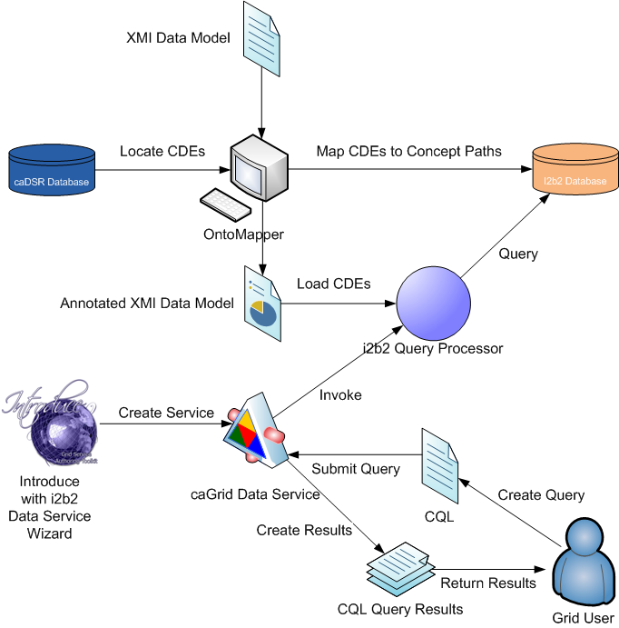
I2b2 – caGrid Data Services

Slide 3
i2b2 – caGrid Data Services
OntoMapper used to annotate data model and i2b2 database with CDEs
CDEs derived from caDSR or OpenMDR
Introduce toolkit with i2b2 Data Service creation wizard generates a caGrid Data Service
Developer specifies annotated XMI data model
Data Service invokes i2b2 CQL Query Processor in response to CQL queries
Query Processor locates CDEs for each class / attribute in the annotated XMI data model
CDEs used to discover i2b2 query paths
Data is extracted from the i2b2 database and processed into CQL query results for the grid user

